Slide 1

David M. Kroenke and David J. Auer Database Processing Fundamentals, Design, and Implementation
Chapter Seven:
SQL for Database Construction
and Application Processing

Slide 2
SQL Categories
SQL statements can be divided into five categories:
Data definition language (DDL)
Data manipulation language (DML) statements
SQL/Persistent Stored Modules (SQL/PSM) statements
Transaction control language (TCL) statements
Data control language (DCL) statements

Slide 3
SQL DDL and DML
Data definition language (DDL)
Statements used for creating tables, relationships, and other structures
Data manipulation language (DML)
Statements used for queries and data modification
SQL/Persistent Stored Modules (SQL/PSM)
Statements used to add procedural programming capabilities
Variables and Control-of-flow statements

Slide 4
SQL SQL/PSM
Transaction control language (TCL) statements
Used to mark transaction boundaries and control transaction behavior
Data control language (DCL) statements
Used to grant (or revoke) database permissions to (from) users and groups

Slide 5
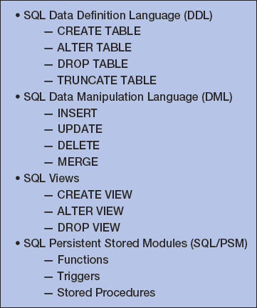
Chapter 7 SQL Elements

Slide 6
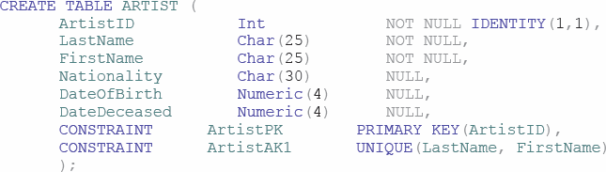
CREATE TABLE (VRG Database)
CREATE TABLE statement is used for creating relations.
Each column is described with three parts: column name, data type, and optional constraints.
Example

Slide 7
Constraints
Constraints can be defined within the CREATE TABLE statement, or they can be added to the table after it is created using the ALTER table statement.
Five types of constraints:
PRIMARY KEY may not have null values
UNIQUE may have null values
NULL/NOT NULL
FOREIGN KEY
CHECK

Slide 8
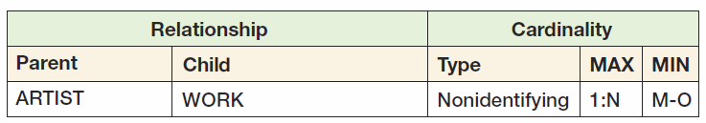
Creating Relationships I

Slide 9
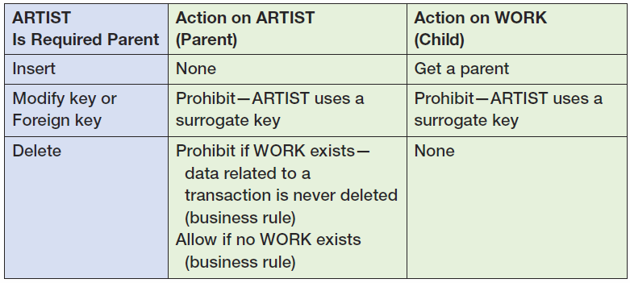
Creating Relationships II

Slide 10
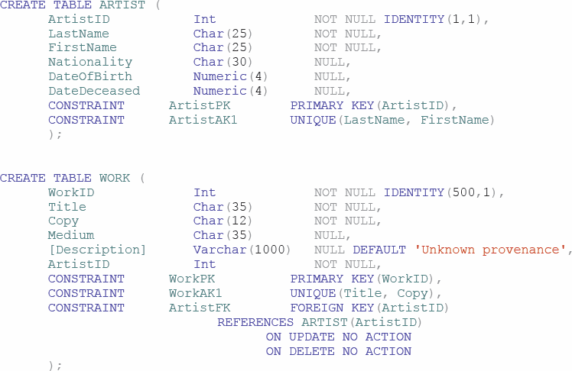
Creating Relationships III

Slide 11
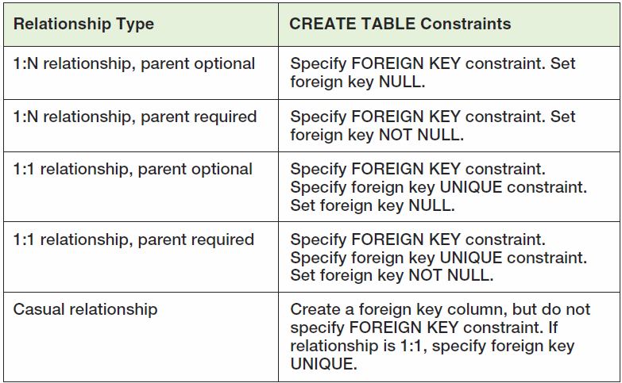
Implementing Cardinalities

Slide 12
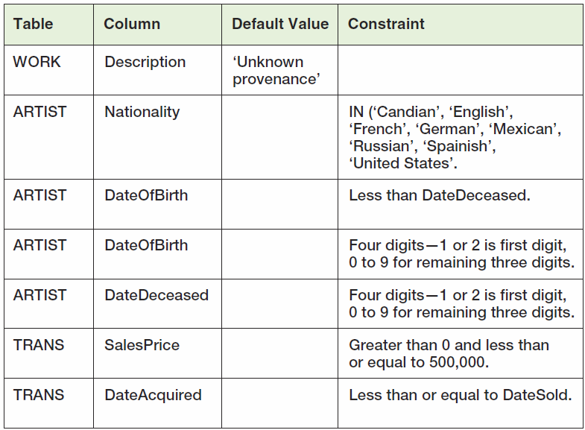
Default Values and Data Constraints

Slide 13
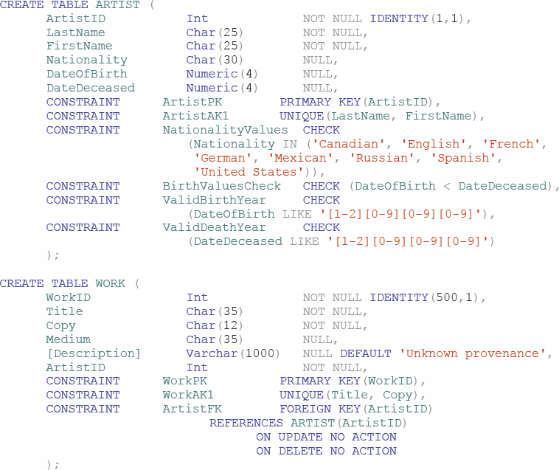
SQL for Constraints

Slide 14
ALTER TABLE Statement
ALTER TABLE statement changes table structure, properties, or constraints after it has been created.
Example
ALTER TABLE ASSIGNMENT
ADD CONSTRAINT EmployeeFK
FOREIGN KEY (EmployeeNumber)
REFERENCES EMPLOYEE (EmployeeNumber)
ON UPDATE CASCADE
ON DELETE NO ACTION;

Slide 15
Adding and Dropping Columns
The following statement will add a column named MyColumn to the CUSTOMER table:
ALTER TABLE CUSTOMER ADD MyColumn Char(5) NULL;
You can drop an existing column with the statement:
ALTER TABLE CUSTOMER DROP COLUMN MyColumn;

Slide 16
Adding and Dropping Constraints
ALTER TABLE can be used to add a constraint as follows:
ALTER TABLE CUSTOMER
ADD CONSTRAINT MyConstraint CHECK
(LastName NOT IN ('Robert-No-Pay'));
ALTER TABLE can be used to drop a constraint:
ALTER TABLE CUSTOMER
DROP CONSTRAINT MyConstraint;

Slide 17
Removing Tables
SQL DROP TABLE:
DROP TABLE TRANS;
If there are constraints:
ALTER TABLE CUSTOMER_ARTIST_INT
DROP CONSTRAINT Customer_Artist_Int_CustomerFK;
ALTER TABLE TRANS
DROP CONSTRAINT TransactionCustomerFK;
DROP TABLE CUSTOMER;

Slide 18
Removing Data Only
SQL TRUNCATE TABLE:
TRUNCATE TABLE TRANS;
Cannot be used with a table that is referenced by a foreign key constraint.

Slide 19
SQL DML—INSERT
SQL INSERT statement:
INSERT INTO ARTIST (LastName, FirstName, Nationality, DateOfBirth, DateDeceased)
VALUES
('Tamayo', ‘Rufino', 'Mexican', 1899, 1991);
Bulk INSERT:
INSERT INTO ARTIST
(LastName, FirstName, Nationality, DateOfBirth)
SELECT LastName, FirstName, Nationality,
DateOfBirth
FROM IMPORTED_ARTIST;

Slide 20
SQL DML—UPDATE
SQL UPDATE statement:
UPDATE CUSTOMER
SET City = 'New York City'
WHERE CustomerID = 1000;
Bulk UPDATE:
UPDATE CUSTOMER
SET AreaCode = '333'
WHERE City = 'Denver';

Slide 21
SQL DML—MERGE
SQL MERGE command:
MERGE INTO ARTIST AS A
USING ARTIST_DATA AS ADR
ON (A.LastName = ADR.LastName
AND
A.FirstName = ADR.FirstName
WHEN MATCHED THEN
UPDATE SET
A.Nationality = ADR.Nationality
WHEN NOT MATCHED THEN
INSERT (LastName, FirstName, Nationality);

Slide 22
SQL DML—DELETE
SQL DELETE statement:
DELETE FROM CUSTOMER
WHERE CustomerID = 1000;
If you omit the WHERE clause, you will delete every row in the table.

Slide 23
Using Aliases
Use of aliases:
SELECT C.Name, A.Name
FROM CUSTOMER AS C
JOIN
CUSTOMER_ARTIST_INT AS CI
ON C.CustomerID = CI.CustomerID
JOIN ARTIST AS A
ON CI.ArtistID = A.ArtistID;
DBMS products differ
CUSTOMER AS C versus CUSTOMER C

Slide 24
SQL Views
An SQL view is a virtual table that is constructed from other tables or views.
It has no data of its own, but obtains data from tables or other views.
SELECT statements are used to define views:
A view definition may not include an ORDER BY clause.
SQL views are a subset of the external views:
They can be used only for external views that involve one multivalued path through the schema.

Slide 25
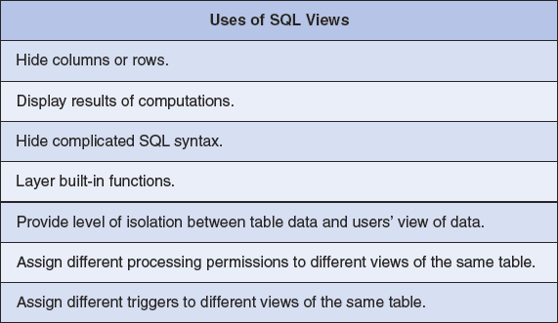
SQL Views

Slide 26
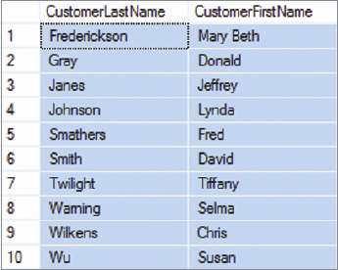
CREATE VIEW Command
CREATE VIEW command:
CREATE VIEW CustomerNameView AS
SELECT LastName AS
CustomerLastName,
FirstName AS
CustomerFirstName,
FROM CUSTOMER;
Results:
SELECT *
FROM CustomerNameView
ORDER BY CustomerLastName,
CustomerFirstName;

Slide 27
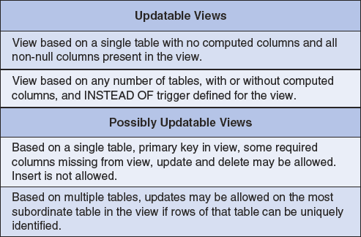
Updateable Views

Slide 28
Embedding SQL in Program Code
SQL cursors are used to select one row at a time from pseudo-files.
Problem: assigning SQL table columns with program variables
Solution: object-oriented programming, PL/SQL
Problem: paradigm mismatch between SQL and application programming language:
SQL statements return sets of rows; an application works on one row at a time
Solution: process the SQL results as pseudo-files

Slide 29
SQL Cursors in Program Code
SQL can be embedded in triggers, stored procedures, and program code.
A typical cursor code pattern is:
DECLARE SQLCursor CURSOR FOR (SELECT * FROM CUSTOMER);
OPEN SQLCursor:
MOVE SQLCursorer to first row
WHILE (SQLCursor not past last row)
LOOP
{SQL action statements go here}
REPEAT LOOP UNTIL DONE;
CLOSE SQLCursor;

Slide 30
SQL/Persistent Stored Modules (SSL/PSM)
SQL/Persistent Stored Modules (SQL/PSM) is an ANSI/ISO standard for embedding procedural programming functionality into SQL
Each DBMS product implements SQL/PSM in a different way, with some closer to the standard than others.
Microsoft SQL Server 2008 R2 calls its version Transact-SQL (T-SQL).
Oracle Database 11g calls its variant Procedural Language/SQL (PL/SQL).
MySQL implements SQL/PSM, but has no special name for its variant of SQL.

Slide 31

User-Defined Functions I
A user-defined function (stored function) is a stored set of SQL statements that:
is called by name from another SQL statement
may have input parameters passed to it by the calling SQL statement, and
returns an output value to the SQL statement that called the function.

Slide 32
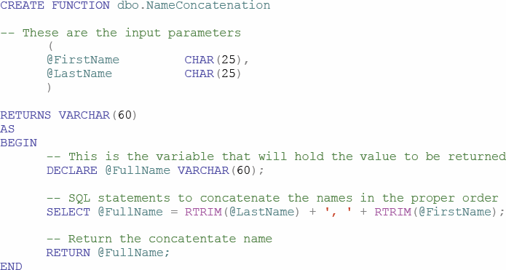
User-Defined Functions II The NameConcatenation Function

Slide 33
User-Defined Functions III The NameConcatenation Function
Using the NameConcatenation function:
SELECT dbo.NameConcatenation(FirstName, LastName) AS CustomerName,
AreaCode, PhoneNumber, Email
FROM CUSTOMER
ORDER BY CustomerName;

Slide 34
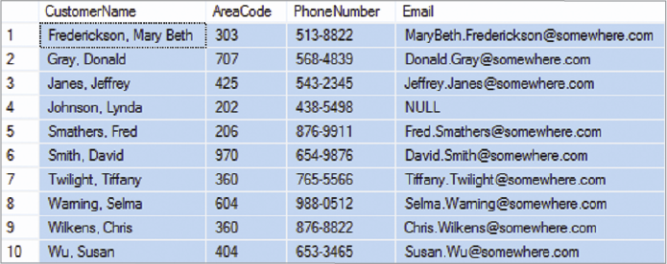
User-Defined Functions IV The NameConcatenation Function
NameConcatenation function results:

Slide 35
Triggers I
A trigger is a stored program that is executed by the DBMS whenever a specified event occurs on a specified table or view.
Three trigger types: BEFORE, INSTEAD OF, and AFTER
Each type can be declared for Insert, Update, and Delete.
Resulting in a total of nine trigger types.
Oracle supports all nine trigger types.
SQL Server supports six trigger types (INSTEAD OF and AFTER).
MySQL supports six trigger types (BEFORE and AFTER).

Slide 36
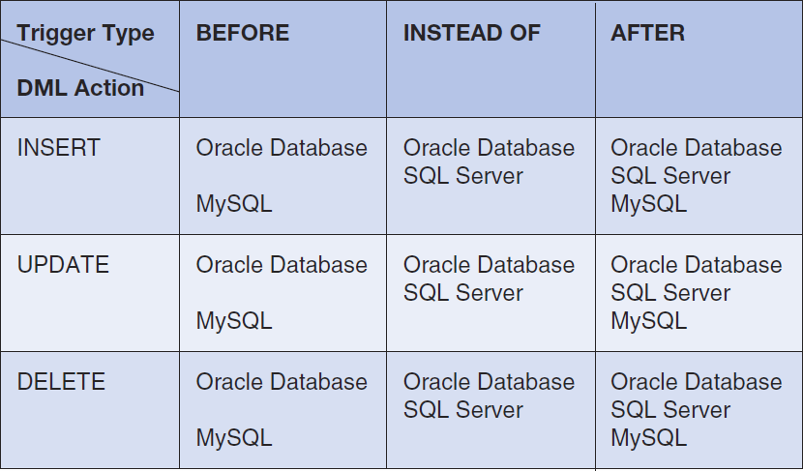
Triggers II

Slide 37
Firing Triggers
When a trigger is fired, the DBMS supplies:
Old and new values for the update
New values for inserts
Old values for deletions
The way the values that are supplied depends on the DBMS product.
Trigger applications include:
Providing default values
Enforcing data constraints
Updating views
Performing referential integrity actions

Slide 38
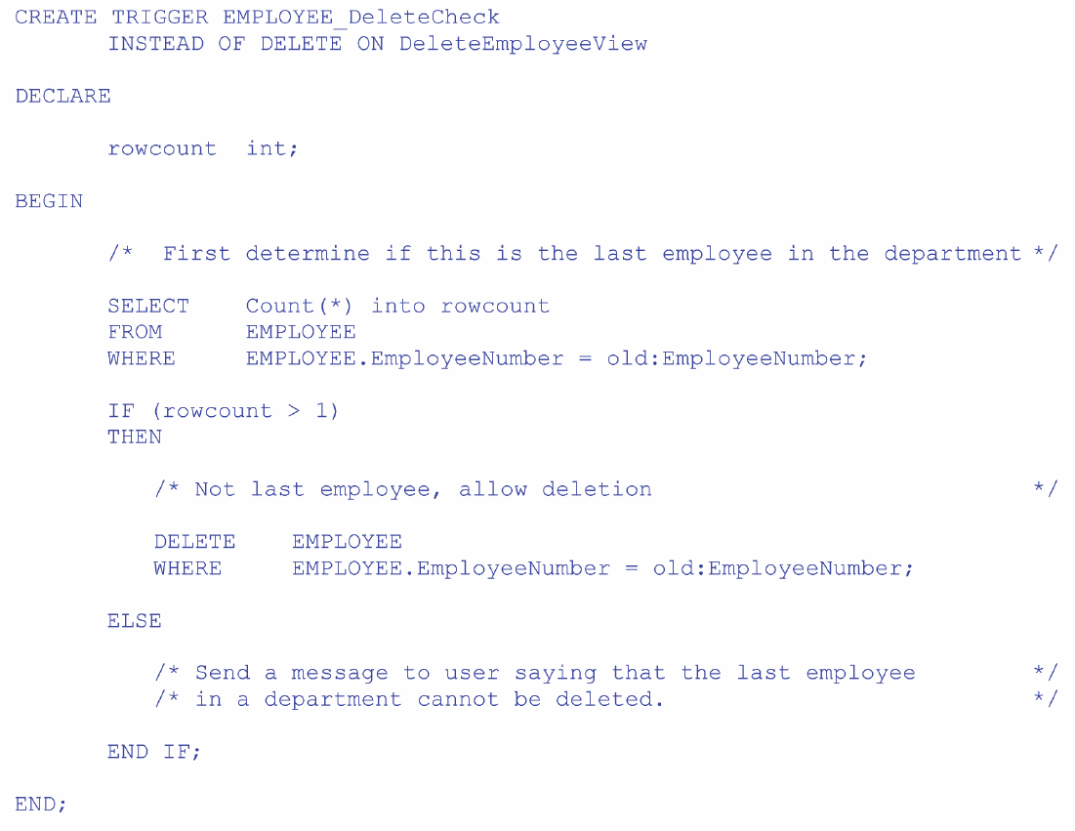

Slide 39
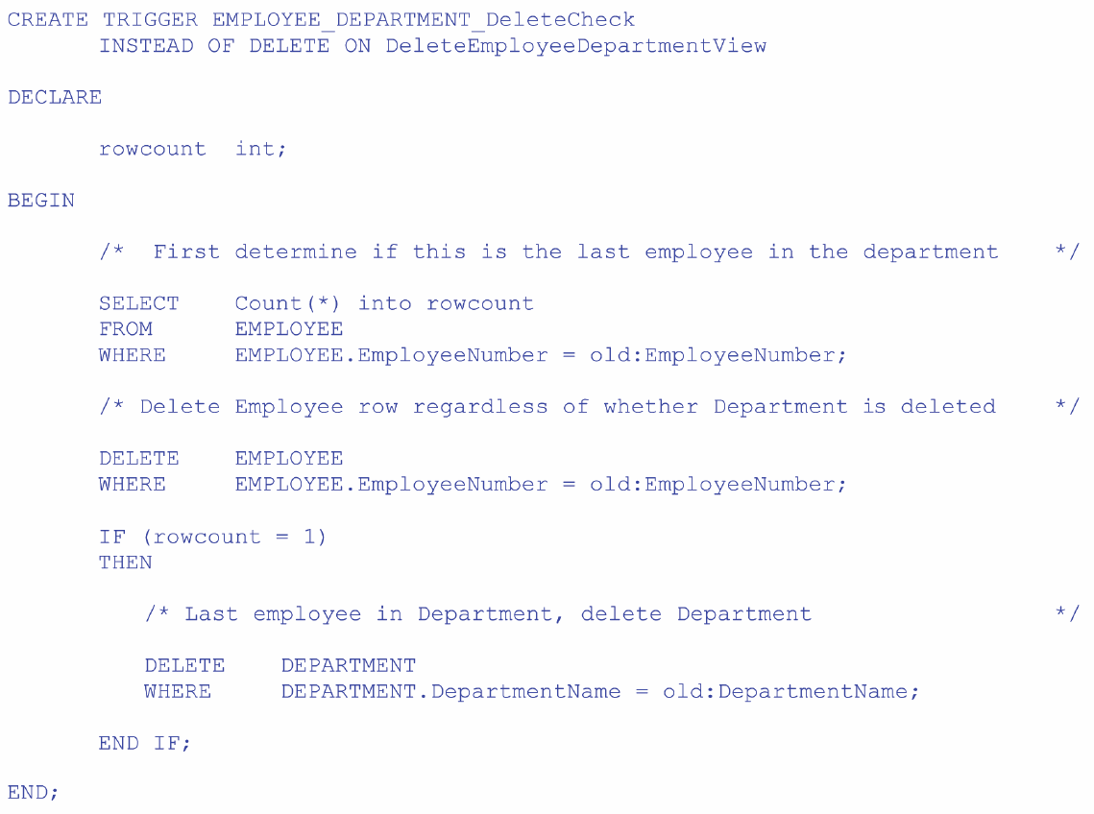

Slide 40
Stored Procedures
A stored procedure is a program that is stored within the database and is compiled when used.
In Oracle, it can be written in PL/SQL or Java.
In SQL Server, it can be written in TRANSACT-SQL.
Stored procedures can receive input parameters and they can return results.
Stored procedures can be called from:
Programs written in standard languages, e.g., Java, C#.
Scripting languages, e.g., JavaScript, VBScript.
SQL command prompt, e.g., SQL Plus, Query Analyzer.

Slide 41
Stored Procedure Advantages
Greater security as stored procedures are always stored on the database server
Decreased network traffic
SQL can be optimized by the DBMS compiler
Code sharing resulting in:
Less work
Standardized processing
Specialization among developers

Slide 42
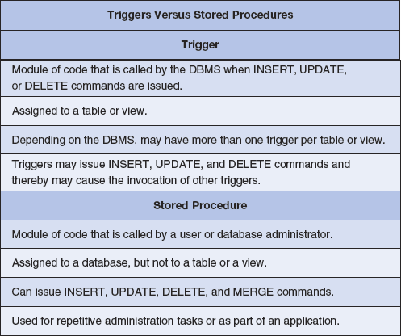
Triggers vs. Stored Procedures

